Slide 1
Initial Location Analysis in San Francisco for
Restaurant La Tierra De Los Tacos
By Daniel Garcia

Slide 2
Background
Restaurante La Tierra De los Tacos needs assistance in filtering out the neighborhoods that don't meet their specific requirements. The want to conduct detailed location analyses into only a select list of neighborhoods in SF that meet all of the following requirements:
Contain a population of 5,000 + (increase opportunity of traffic and visibility)
Near at least one college and surrounded by at least three other types of schools (partnerships with schools and other organizations, and to provide catering/delivery options)
Rent at or below the city's average -$3,000
Median income of $50,000 or more (safeguard for tough financial times)
With minimal competition (mexican restaurants) and similar venues (ie. restaurants) nearby
It is the aim and scope of this report to identify the neighborhoods in SF that meet the aforementioned requirements

Slide 3
Data Sources
ACS 5 Year Estimates (2013-2017) -- Selected Characteristics of the Total and Native Populations in the United States (Census Table ID: 601)
ACS 5 Year Estimates (2014-2018) -- Selected Housing Characteristics (Census Table ID: DP04)
Colleges (2011)
Analysis Neighborhoods - 2010 Census Tracts Assigned to Neighborhoods
Venues retrieved from FourSquare API call

Slide 4
Preprocessing
Duplicate, missing, and irrelevant data as well as columns were dropped
Merging of three datasets into one dataframe
Changed data types of certain columns from the merged dataframe
Also filtered out data based on the first three business requirements
More than 5,000 population
Median income >= $50,000
Gross rent >= $3,000
Was left with 18 tracts out of the original 197 tracts
Retrieved venues using Four Square ‘recommended venues’ api call

Slide 5
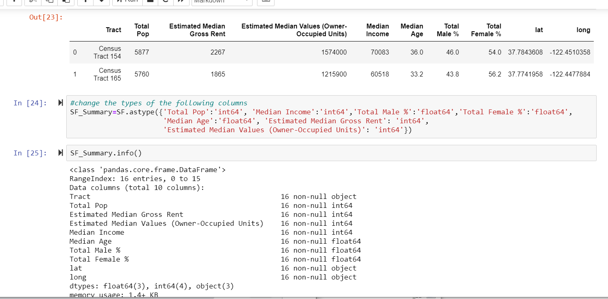
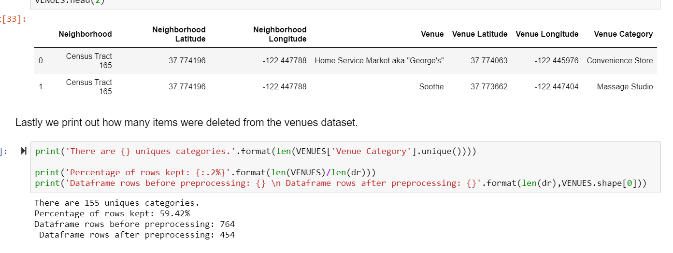
The main SF dataframe
That resulted after preprocessing.
The venues data that was retrieved from FourSquare and then cleaned.

Slide 6
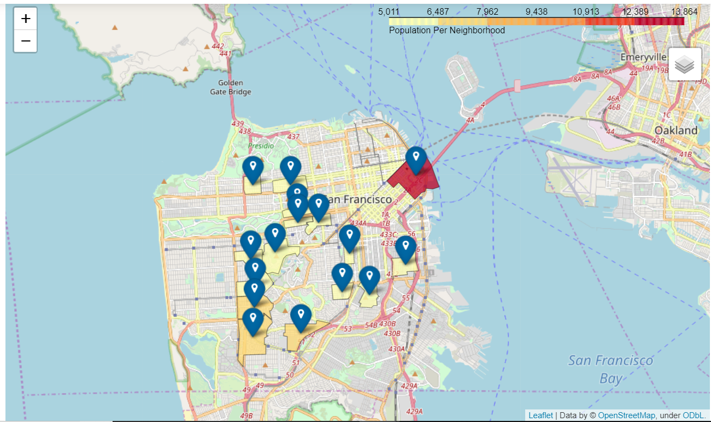
Initial Folium Map Visualizations
Population choropleth map
Select Census tract markers
Population and median income as popup info.
Most of the districts that meet the first three criterias are mostly roughly located around the center and upper east side of SF.

Slide 7
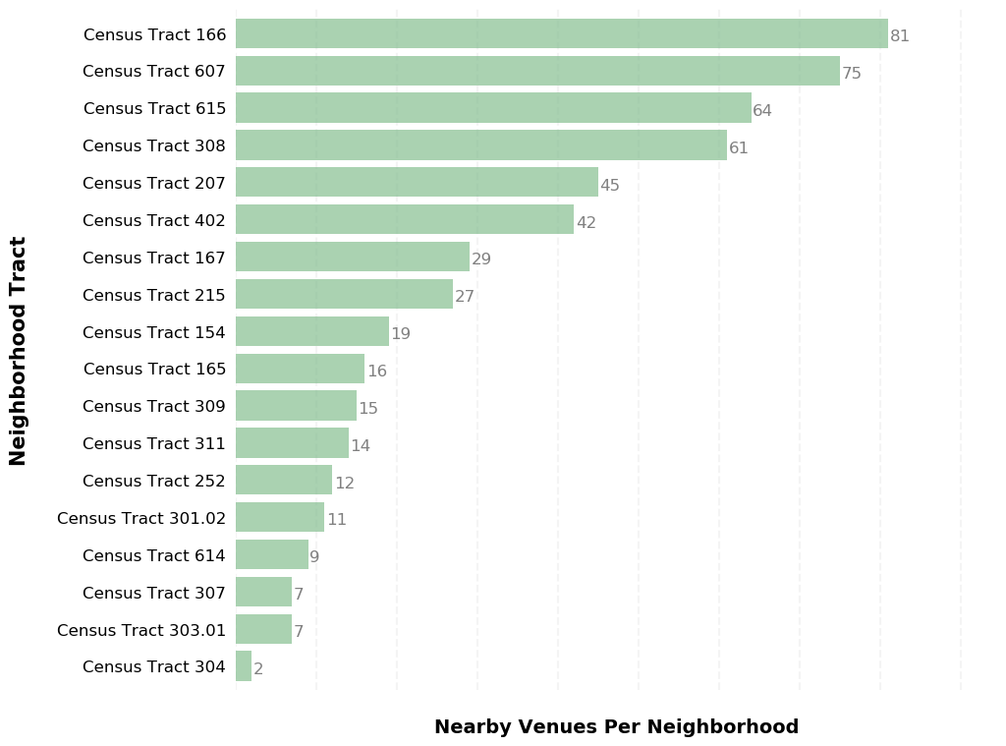
Venue Analysis
Expected a good chunk to be close to 100 given the many restaurants.
81 nearby venues
Roughly half of the tracts having a nearby venue count that is less than 19.

Slide 8
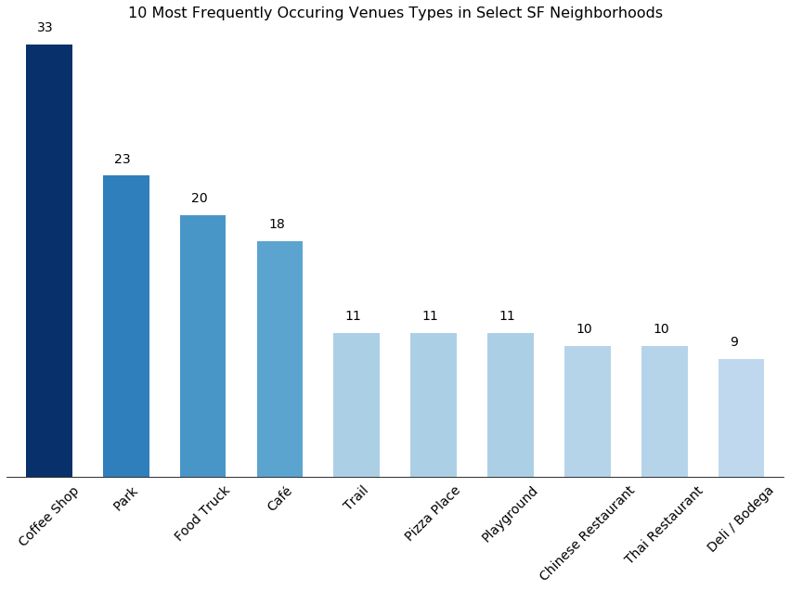
Venues Analysis continued ...
Coffee shops (in combination to cafes) by far the most frequently occurring venues.
Parks were also quite common.

Slide 9
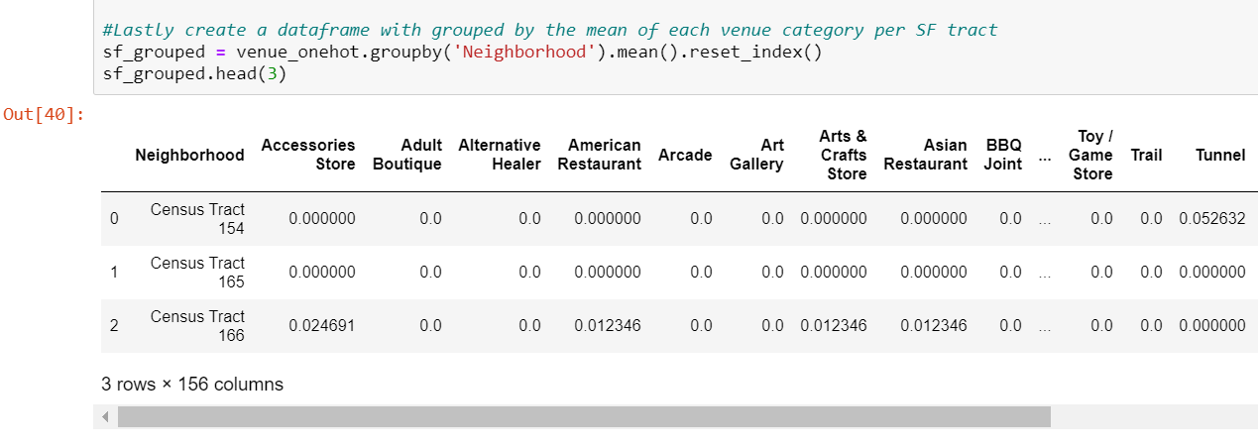
Clustering
Segment tracts according to their venue categories
Applied one-hot encoding technique for the venue categories
Grouped by their venue categories and then took each one of their mean

Slide 10
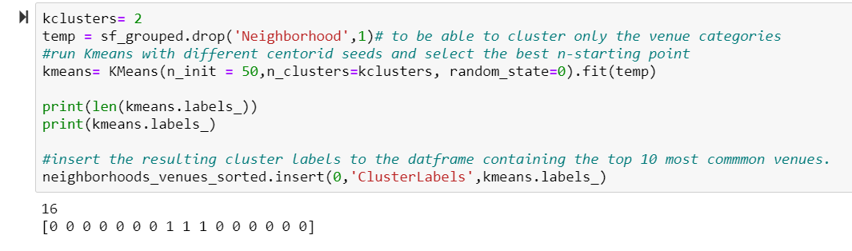
Clustering continued ...
Used the K-Means Algorithm
Given the small size of tracts (16), chose 3 as the K clusters

Slide 11
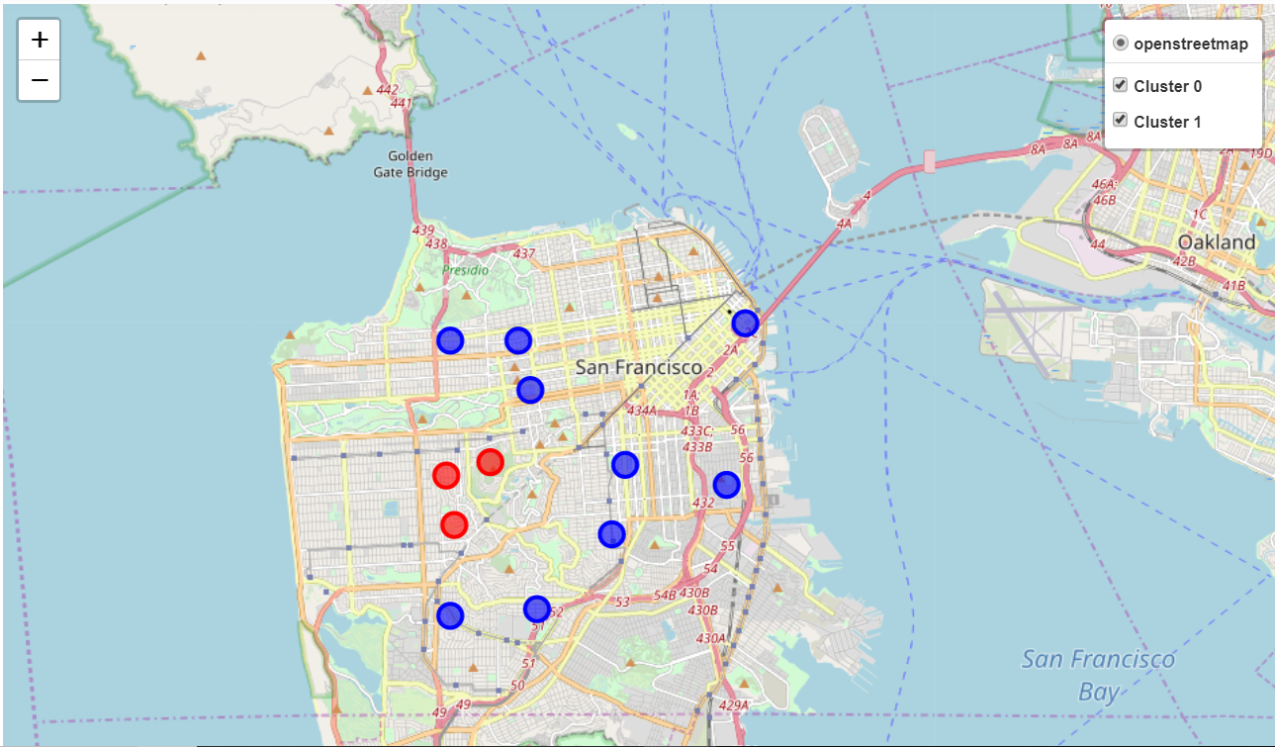
Cluster Map
Chose cluster 0 (blue) as the target cluster
Made some further filters by excluding tracts in the target cluster that contained a Mexican food-related venue

Slide 12
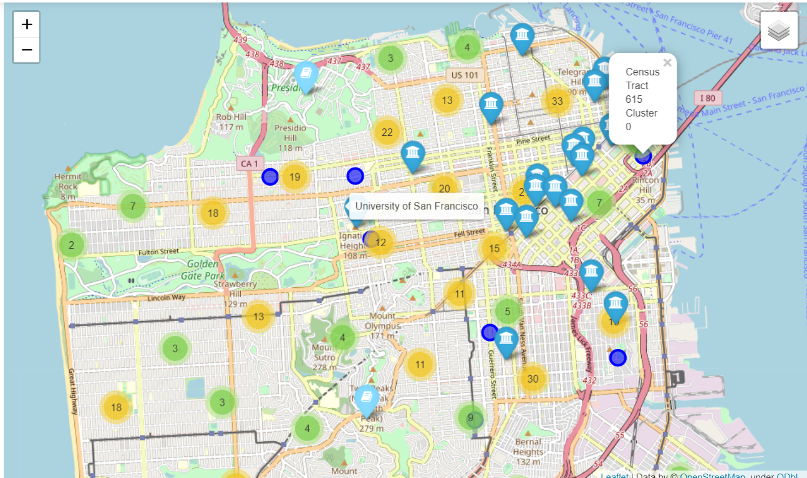
Schools in San Francisco Map
Filtered out tracts 402 and 311 as they didn’t meet the last business requirement.

Slide 13
Discussion and Conclusion
Found seven tracts/neighborhood candidates for the business to choose from
Characterized by coffee shops, outdoor venues such as parks, and asian restaurants.
Scattered around the mid-center of the city.
Affluent with a median income mean of 77,701 dollars, and an average gross rent of 2,229 dollars.
Tract 615 stood --high population size, high median income (103,451 dollars), and proximity to several colleges.
Limitation: Results provide only a direction at which the company can conduct further and more detailed analysis of the suggested neighborhood locations.
Conclusion: Candidate tracts are potential good locations for the company to look further into as the requirements outlined in the introduction of this report.

